Slide 1

Retational
Database
PostgresSQL
Project Portfolio
Delivery Time Analysis
Sailaja Begum
45K+
41K+
42K+
20
Rows od Data
Delivery Rider
Orders
Columns

Slide 2

DELIVERY TIME
Vision
As a new delivery App business Analyst.
Analyse the data to understand the expected delivery time and identify patterns that could impact the delivery times.
Mission
To analyse historical orders delivery data to identidy the average delivery time for each order types.
Normalization of the Dataset.
Data wrangling
Use PostgresSQL to process information on the Database to understand the various relationship between the values .
Export the Data to Excel to use the data for visualization to better understand the data for the stake holder.

Slide 3



INSIGHTS & DESIRED OUTCOME
Summarize
Outcome
Summarize the key findings and insights gained from the analysis, including any trends or patterns in delivery time, and any external factors that have a significant impact on delivery time.
Suggestions for business implementation: Provide recommendations for how the business can use this analysis to improve delivery time, such as optimizing routes, adjusting staffing levels, or providing real-time updates to customers.

Slide 4
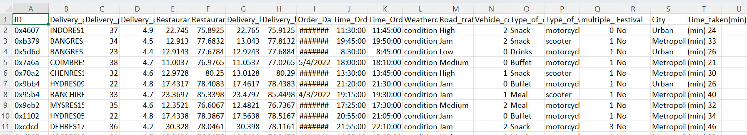
Data Source:
https://www.kaggle.com/datasets/gauravmalik26/food-delivery-dataset
DENORMALIZED RAW DATA

Slide 5


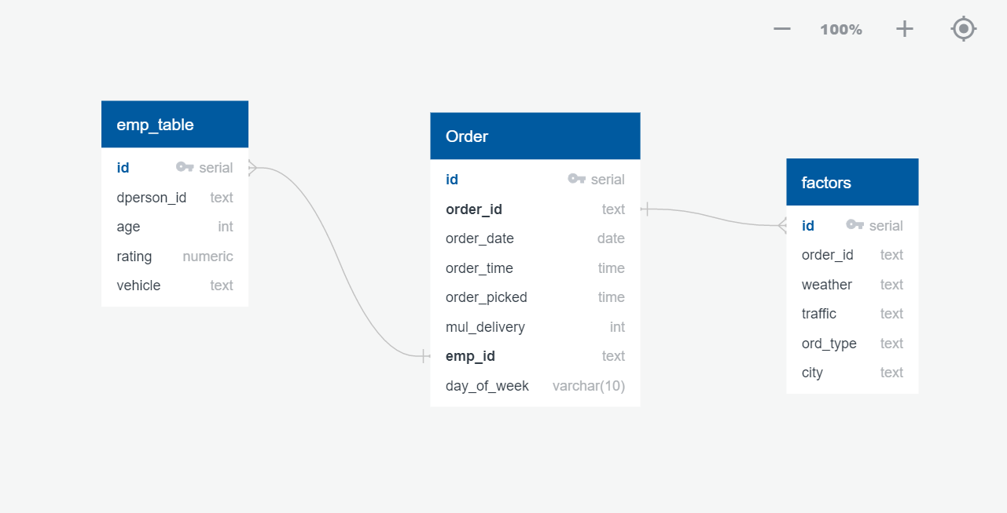

Schema & Table Diagram:
Employee Table
Orders Table
Factors Table

Slide 6
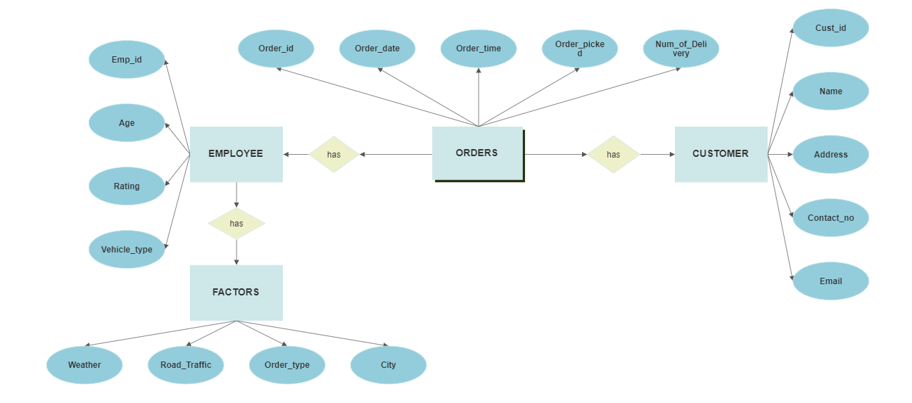
ENTITY RELATIOSHIP DIAGRAM

Slide 7
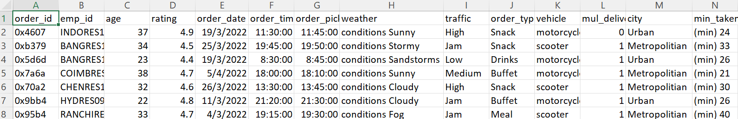
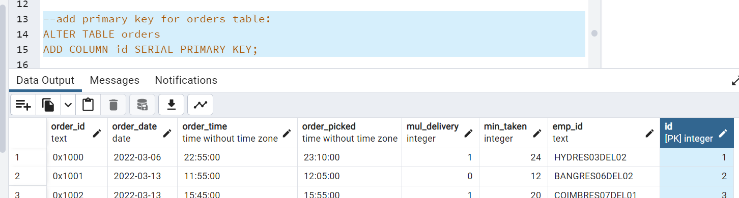

NORMALIZATION
Design a database effectively to avoid redundancy of data
Restructure the database by coming up with multiple table with specific data.
Build relationship between the tables
Create unique identification for each rows of data (Primary Key) and the coonection with other table (Foreign Key)

Slide 8
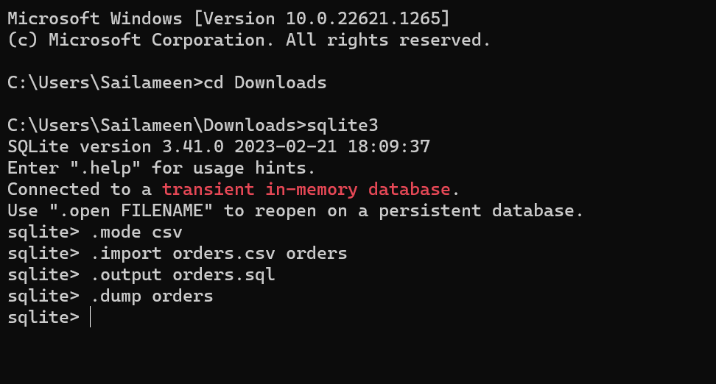
DATA UPLOAD SQLite3 COMMAND LINE

Slide 9
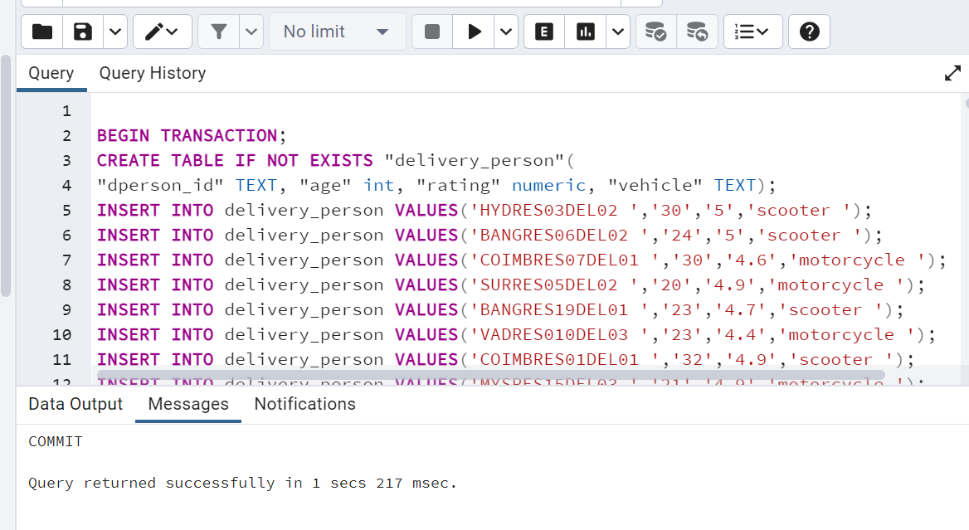
DATA IMPORT to POSTGRESSQL

Slide 10

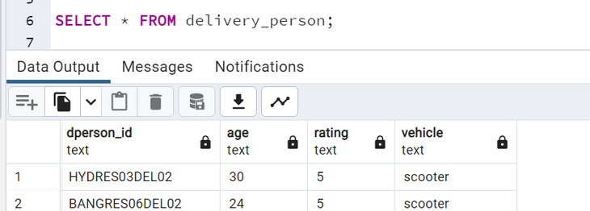
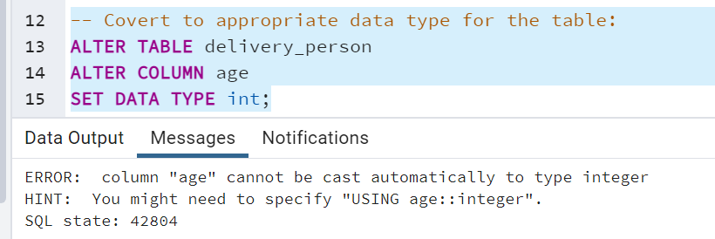

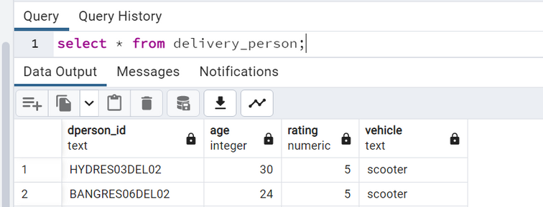
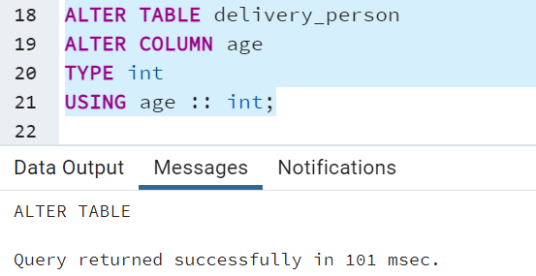
DATA WRANGLING
DATA CLEANING
Cleaning, trainsforming and preparing complex data for analysis
Remove Redundant Colums
Remove Blank cells and rows with incomplete data
Update proper Data Type for the columns

Slide 11
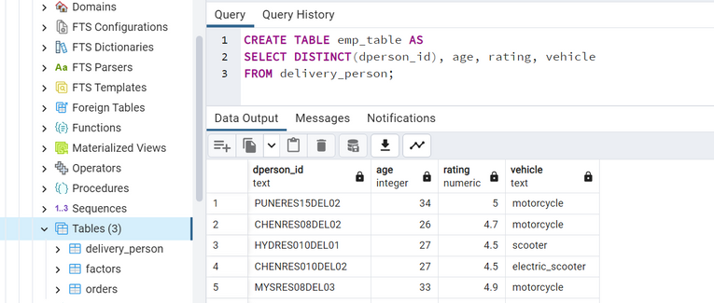
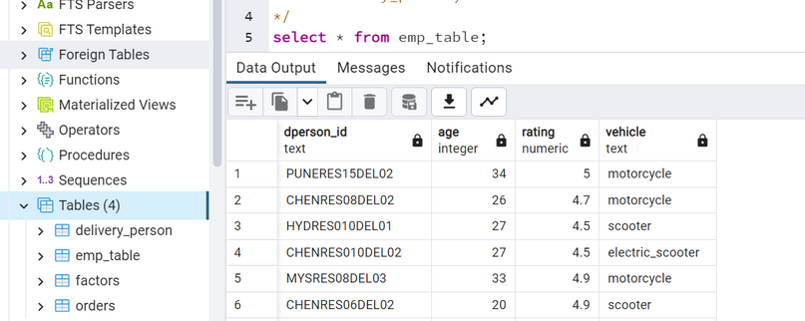
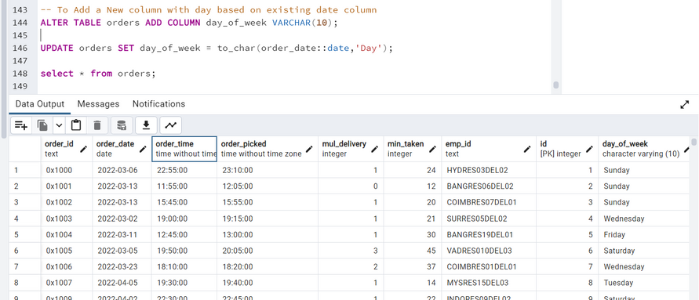
DATA WRANGLING
DATA Structuring
Organizing data in a stuctures and meaningful way to improve the data usability for Data Analysis
Create a Distinct New table from existing table
Add a New column by extracting day from Date column for Analysis

Slide 12






Analysis can be done base on:
Weather condition
Hours of the Day
Road Traffic condition
Vehicle type
Location
Ratings

Slide 13
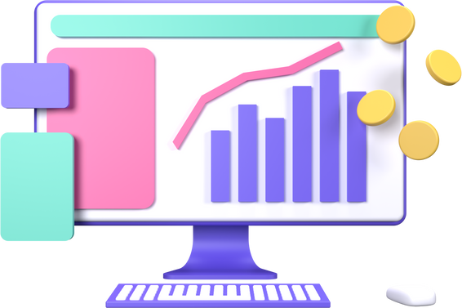
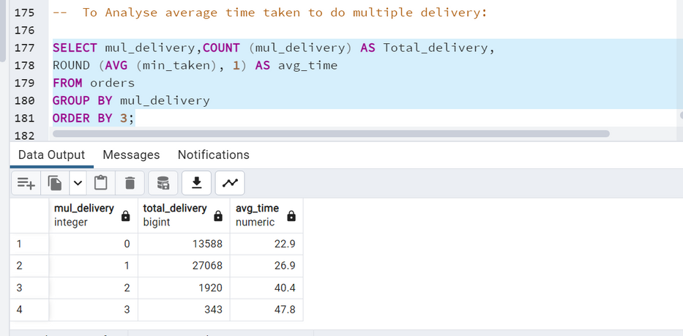
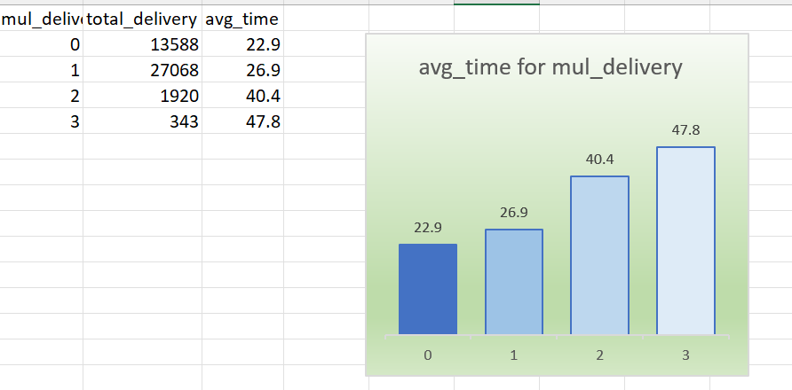
DATA QUERIES & DATA ANALYSE
Analyse Average Time Needed for each type of deliveries

Slide 14
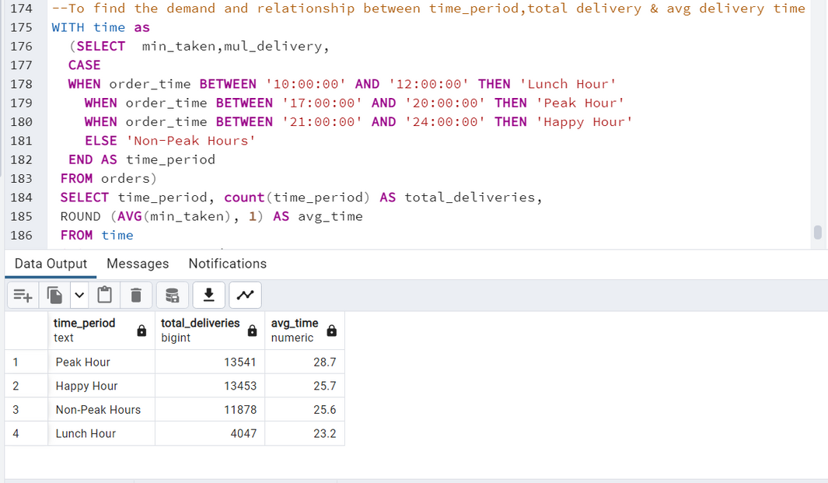
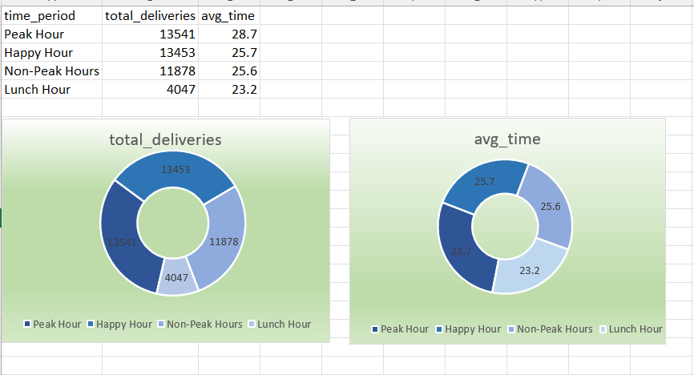
DATA QUERIES & DATA ANALYSE
To Analyse the demand and relationship between time_period , total delivery & avg delivery time

Slide 15
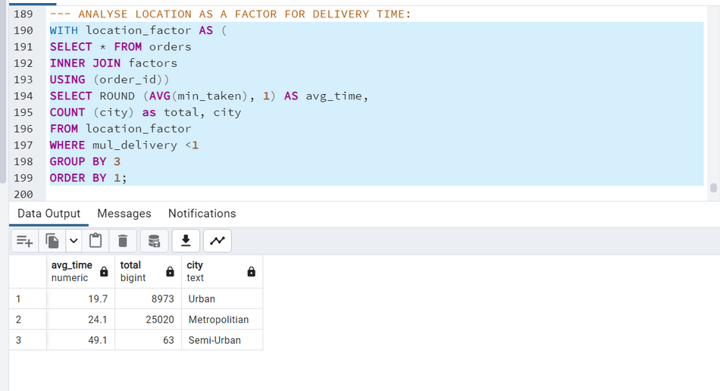
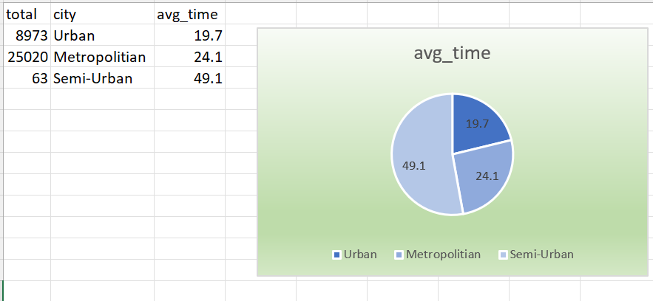
DATA QUERIES & DATA ANALYSE
Analyse Location factors affecting average delivery time

Slide 16
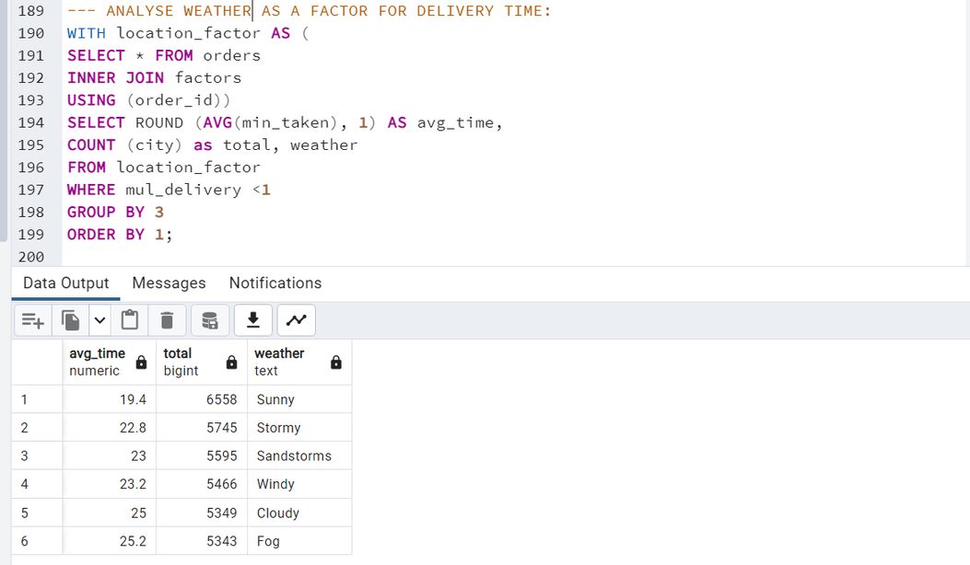
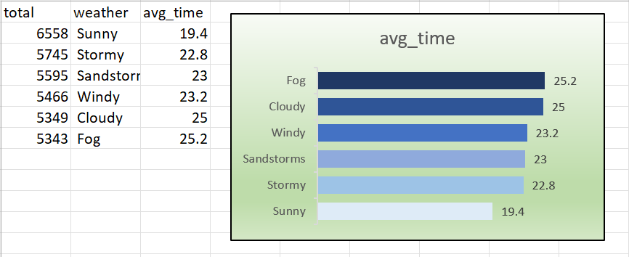
DATA QUERIES & DATA ANALYSE
Analyse Weather facfor affecting average delivery time

Slide 17

Time to order!
Thank You.

